Slide 1
Smeal Academy GenAI Series - Update and Resources
September 24, 2024

Slide 2
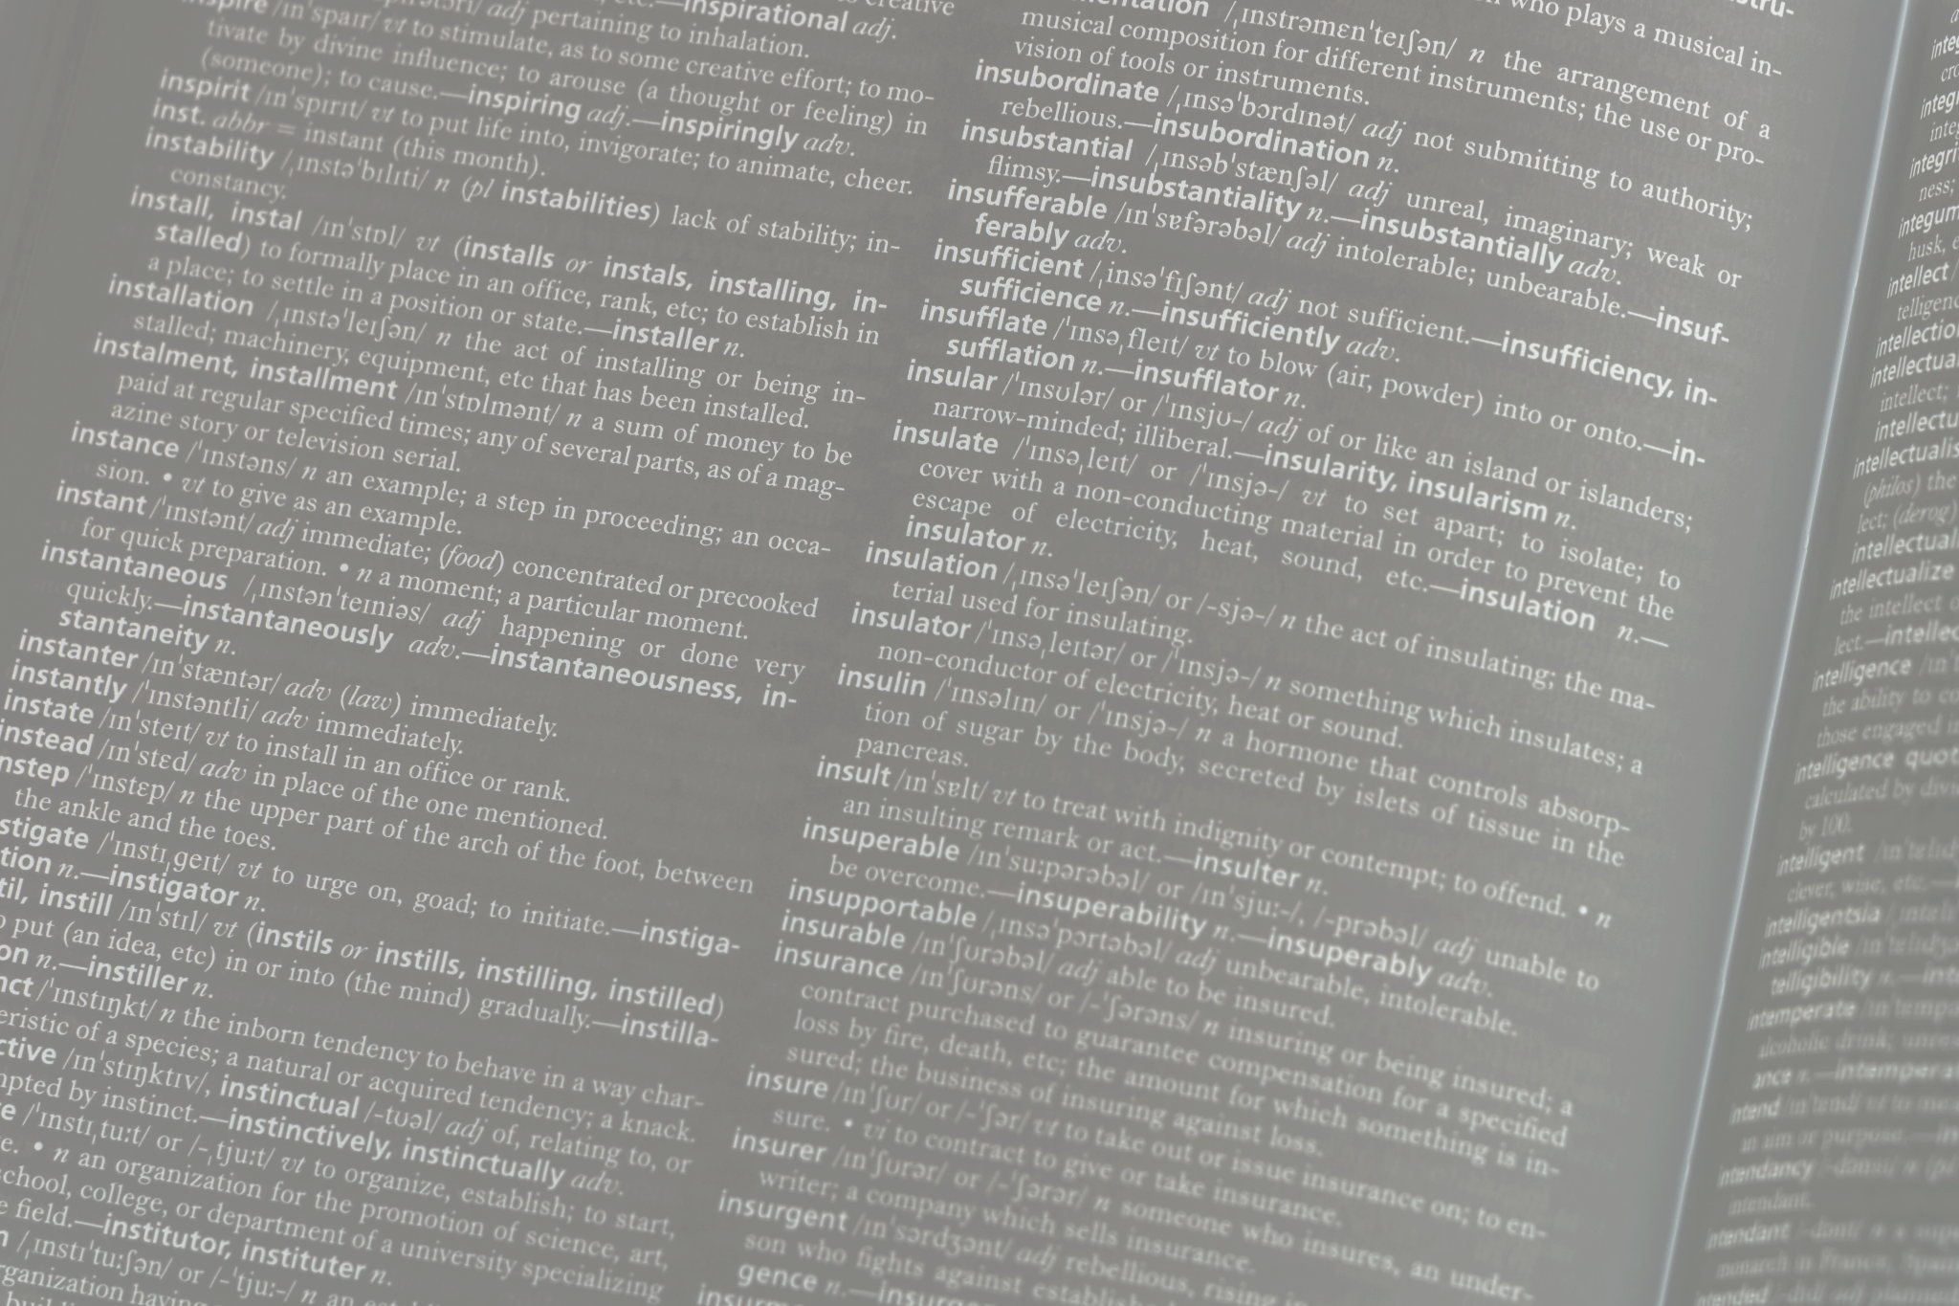
Definitions
Artificial Intelligence is "a machine-based system that can, for a given set of human-defined objectives, make predictions, recommendations or decisions influencing real or virtual environments" (Robert, 2024).
GenAI (Generative Artificial Intelligence) “refers to deep-learning models that can generate high-quality text, images, and other content based on the data they were trained on” (Martineau, 2023).
Taken from the Final Report of the Joint Standing Committee on Effective and Responsible Use of Artificial Intelligence in Higher Education Instruction (2024, May)

Slide 3
University Guidance on GenAI in Instruction
What is Penn State’s position on GenAI?
Potential benefits when used responsibly and ethically
Emphasis on thoughtful and informed decision-making for course integration​(GenAI Policy)
Guidelines for Use in the Classroom:
Recommended tools: Microsoft Copilot (no training of the model, SSO login)
Guidelines for tools like ChatGPT and Claude​
(GenAI FAQ Email from Fa…)​(GenAI Policy)

Slide 4
Integrating GenAI Policies into Course Syllabi
How to talk about GenAI in your syllabus
Permissible uses (e.g., specific assignments)
Prohibited uses (plagiarism, misuse)​(GenAI Policy)
Importance of open communication and setting clear course policies
Link to sample syllabus language​

Slide 5
Clarifying Expectations
Sample Orientation Lessons
Red Banner/Icon - GenAI Prohibited Lesson
Green Banner/Icon - GenAI Permitted Lesson
Yellow Banner/Icon - GenAI Permitted with Careful Consideration Lesson

Slide 6
GenAI Strategies for Course Assignments
Course Assignment Icons

Slide 7
GenAI Strategies for Course Assignments
Course Assignment Icons

Slide 8
GenAI Strategies for Course Assignments
Course Assignment Icons

Slide 9
Can I Require It In My Course?
Free Microsoft Copilot (Bing chat/free version) —YES. Offers commercial data protection, doesn't train the model, and saves no chats. Faculty should provide alternative assessments for students opting out of GenAI use.
Free vs. M365 Copilot Usage—Free Copilot is available to all PSU users. M365 Copilot costs $360/year via the Penn State software store. M365 PAID Copilot Info.
Other LLMs (ChatGPT, Gemini, Claude)—NO. You cannot require students to use these tools or create accounts. Faculty must offer alternate assignments and submit a courseware request before using these tools.

Slide 10
What About AI Detection Tools?
These are undependable.
Image generated by DALL·E, OpenAI. 2024.

Slide 11
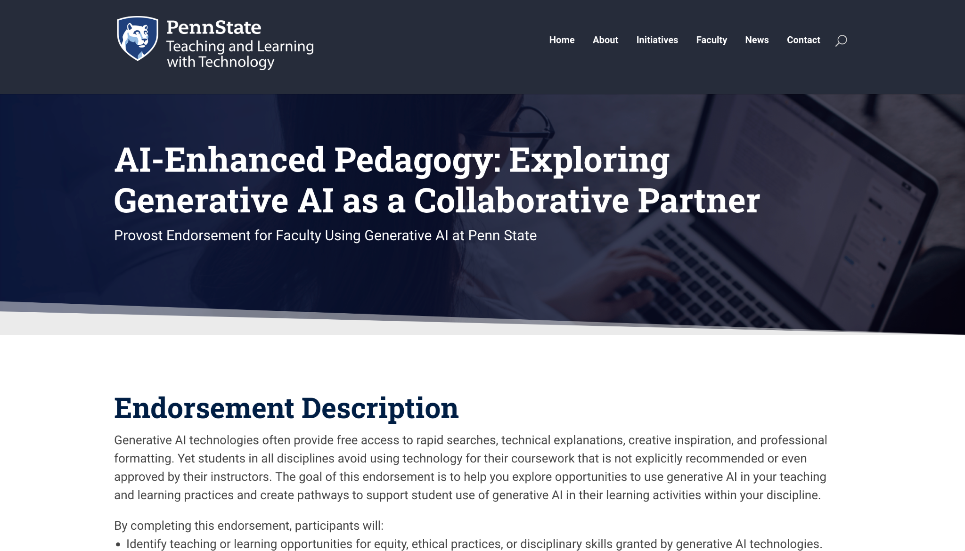
Provost’s AI-Enhanced Pedagogy Endorsement
Overview of the Provost’s endorsement on AI-enhanced pedagogy
explore opportunities to use generative AI in your teaching and learning practices
create pathways to support student use of generative AI in course learning activities within your discipline
Benefits for faculty: recognition and resources
Registration Closes September 30th
Notes:
https://pennstate.qualtrics.com/jfe/form/SV_3W8G0nCKg1jIDxs

Slide 12
AI Tools & Data Privacy
Data privacy concerns and appropriate use of AI tools
Levels of data sensitivity (FERPA, student privacy)​(GenAI Policy)
Best practices for uploading materials into GenAI tools
Faculty responsibility in handling student data​(GenAI Policy)
Tools: Microsoft Copilot vs. other LLMs (e.g., ChatGPT)
Notes:
We can share only public, non-confidential information in any GenAI tool. This means we likely can't technically anonymize a student's paper and upload it to ChatGPT or GPTZero to try to determine whether a student used GenAI to complete an assignment (and the university is explicitly recommending against using detection software because it's unreliable).

Slide 13
Student Data Considerations
In addition to FERPA considerations, there are ethical concerns with sharing student data--without their knowledge--that could be used to train LLMs.

Slide 14
Level 1 Data
Data made freely available by public sources
Published data
Educational data
Initial and intermediate Research Data
Only Level 1 Data can be entered into tools other than Microsoft Copilot.

Slide 15
Level 2 Data
Non-PII student records
Personnel records

Slide 16
GenAI Resources and Support
eLDIG Website
Penn State AI Hub
Penn State AI Guidelines
Penn State AI Literacy Modules
Penn State GenAI Library Guide

Slide 17
Discussion and Questions
eldig@smeal.psu.edu

