Slide 1

Engaging Students via Microlearning
Brett Bixler​
Instructional Designer​
e-Learning Design Innovation Group (eLDIG)​
Smeal College of Business​
Penn State University​

Slide 2
What is Microlearning?
Small content snippets between 2-10 minutes in length centered on one learning objective.
Content is organized and delivered in small chunks.
Support is provided to encourage comprehension.
Students can see the entire “path” – know where they are.
Provide links to more, in-depth information.

Slide 3
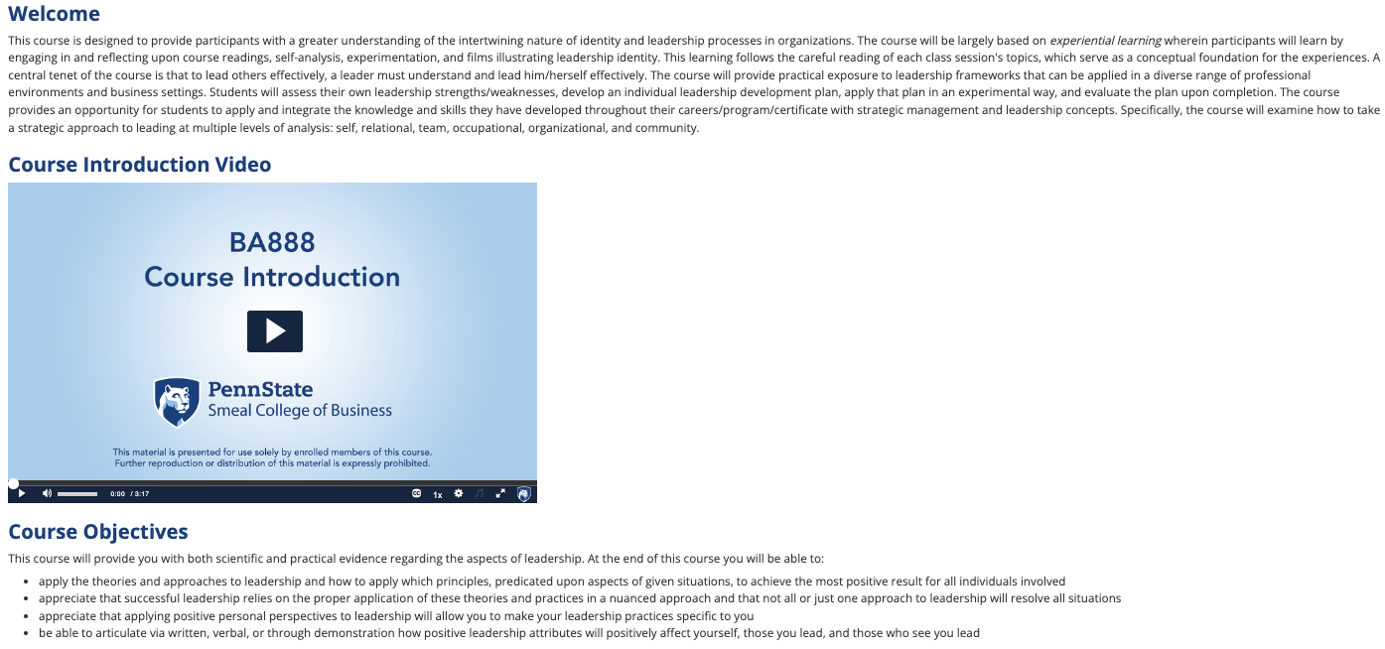
Course Intro - The “Traditional” Way

Slide 4
The Microlearning Way
Course Introduction

Slide 5
Why Use Microlearning?
Cognitive Load Reduction
Intrinsic - The inherent difficulty of the subject matter.
Extrinsic – The way new information is presented.
Germane – The integration of new information into memory (schema).
Microlearning can reduce extrinsic cognitive load. It may help optimize germane cognitive load as well.

Slide 6
This is BORINGzzzz…..
The Nature of Drama
Aristotle, then, conceived of tragedy as being the imitation of a major deed or action depicting through its enactment the striving of the human soul toward some goal with the intention of purging negative emotion while teaching oblique lessons of life. In examining the art form with his students, the Greek teacher concluded that tragedy contained six elements or components--plot, character, thought, diction, music and spectacle. Of the elements, three--plot, character and thought--were essentially the subject of plays; that is to say, plays are about stories and people and ideas. Two of the elements--diction and music--represent the tools or materials playwrights use to fashion their drama. Dramatists employ words, sound and symbols as well as verse and rhythm and music to create the play script. And the final element, spectacle, relates to the manner in which the art is presented to the consumer--in this case a staged production in a theatre.
Of all the elements, according to Aristotle, plot was the most important; he referred to it as "the first principle," "the soul of tragedy," "the first and most important part of Tragedy," and "the first level of all imitation," He was convinced, it would seem, that a play needed a strong storyline in order to accomplish its purpose. He probably reasoned that if you wished to write a play imitating a major action such as "to re-establish God's order in the realm," then the most expeditious and practical way to accomplish your aim was to find a story that could be used to demonstrate such a quest--just as Shakespeare did in Hamlet. "Plot," he said, "is the imitation of the action." By "action" in this instance he meant the one major profound deed that the play will depict; and plot now becomes the primary means of depicting or imitating that deed or action.

Slide 7
This is BETTER!
The Nature of Drama
Introduction
The purpose of this reading is to introduce you to the key elements of a Greek tragedy according to Aristotle.
When you complete this reading, you should be able to list without error the six elements of a Greek tragedy. You should be able to describe in writing Aristotle's conception of the plot, including all four of his descriptions.

Slide 8
This is BETTER! 2
Aristotle, then, conceived of tragedy as being the imitation of a major deed or action depicting through its enactment the striving of the human soul toward some goal with the intention of purging negative emotion while teaching oblique lessons of life.
In examining the art form with his students, the Greek teacher concluded that tragedy contained six elements or components:
• Plot • Diction
• Character • Music
• Thought • Spectacle

Slide 9
This is BETTER! 3
Of the elements, three - plot, character and thought - were essentially the subject of plays; that is to say, plays are about stories and people and ideas.
Two of the elements - diction and music - represent the tools or materials playwrights use to fashion their drama.
Dramatists employ words, sound and symbols as well as verse and rhythm and music to create the play script.
And the final element, spectacle, relates to the manner in which the art is presented to the consumer - in this case a staged production in a theatre.

Slide 10
This is BETTER! 4
Of all the elements, according to Aristotle, plot was the most important; he referred to it as:
"The first principle"
"The soul of tragedy"
"The first and most important part of Tragedy"
"The first level of all imitation"

Slide 11
This is BETTER! 5
He believed a play needed a strong storyline in order to accomplish its purpose. You need a story that demonstrates such a quest--just as Shakespeare did in Hamlet.
"Plot," he said, "is the imitation of the action.”
By "action" in this instance he meant the one major profound deed that the play will depict. Plot now becomes the way to depict or imitate that deed.

Slide 12
This is BETTER! 6
Follow-up Questions
What are the six elements of a Greek tragedy?
How does Aristotle describe a plot? List all four ways.

Slide 13
This is BETTER! 7
Summary
Aristotle believed that a Greek tragedy contained the following elements:
Plot
Character
Thought
Diction
Music
Spectacle

Slide 14
This is BETTER! 8
Of these, he believed that plot was the most important. He referred to it as:
"The first principle"
"The soul of tragedy"
"The first and most important part of Tragedy"
"The first level of all imitation"
See the full example…

Slide 15
What Was Done Here?
Objective(s) listed.
Advanced organizer provided.
Titles used to divide major sections.
Headings used to sub-divide a major section.
The text body was divided into paragraphs with plenty of white space. Avoid small font sizes (below 12 point).
Short sentences used.
Bolding (via the Strong style) applied to emphasize key points/words.
Questions and feedback used periodically to point readers to the key places in the text.
Summary provided, including all key points.

Slide 16
Microlearning – The First Step
Use the steps just provided to rewrite your text content.
This takes TIME!!!
Ask yourself – are there other media (graphics, etc.) that will add to the content – make it better? If so, consider adding them.
Again – that takes TIME!!!

Slide 17
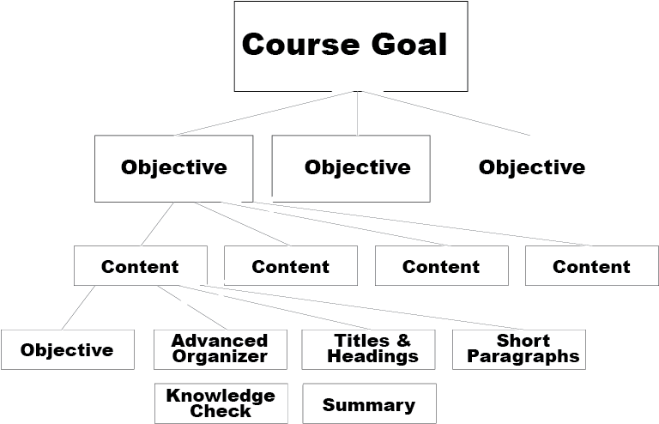
How Can I Rewrite My Content?
Notes:
Objectives, Advanced Organizer, Titles and Headings, Short Paragraphs, Knowledge Checks, and a Summary all feed into a chunk of content. Multiple chunks of content feed into and objectives. Multiple objectives feed into the course goal.

Slide 18
Here’s Another Example
Business Fundamentals

Slide 19
We’re Experimenting….
Course Introduction by eLDIG

Slide 20
Let’s Try It!
Download and open the Word Doc from Chat.
Check it out.
In chat, type your ideas on how to better present the content. Keep in mind:
Objectives
Advanced organizer
Titles & Headings
Short paragraphs
Questions and feedback
Summary

Slide 21
What About Canvas?
You can rewrite your content and place it on a Canvas page, with horizontal lines separating each piece of content.
You can use a Canvas quiz to add timely questions. Include the content in the question so the question itself appears ”in the flow.”
Canvas Example

Slide 22
In Summary…
Take original content and break it down into bite-size chunks. Only the bare bones! 5-7 minutes each.
Provide supports & feedback to optimize comprehension.
Show the students where they are in the learning path.
Provide links to more information – deeper dives.

Slide 23

Questions?

